Slide 1
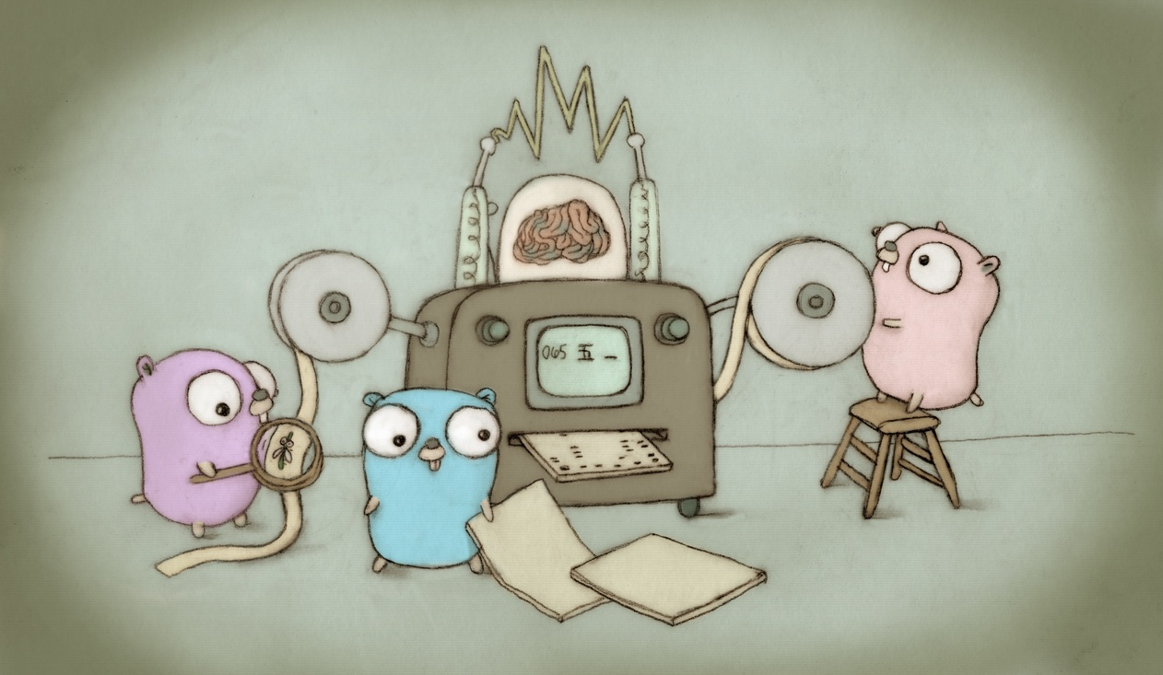
Go Miami/FLL
March 1st, 2018
Go 1.10 Release Party
Guillaume J. Charmes – Magic Leap
Twitter @charme_g
Github: @creack

Slide 2

Go 1.10 Release Party
About the meetup
New management
Schedule
Upcoming talks
Code Reviews
CFP

Slide 3

Go 1.10 Release Party
What’s new?
Strings builder
Package cache management
Test cache
Full blown context
And many more!

Slide 4
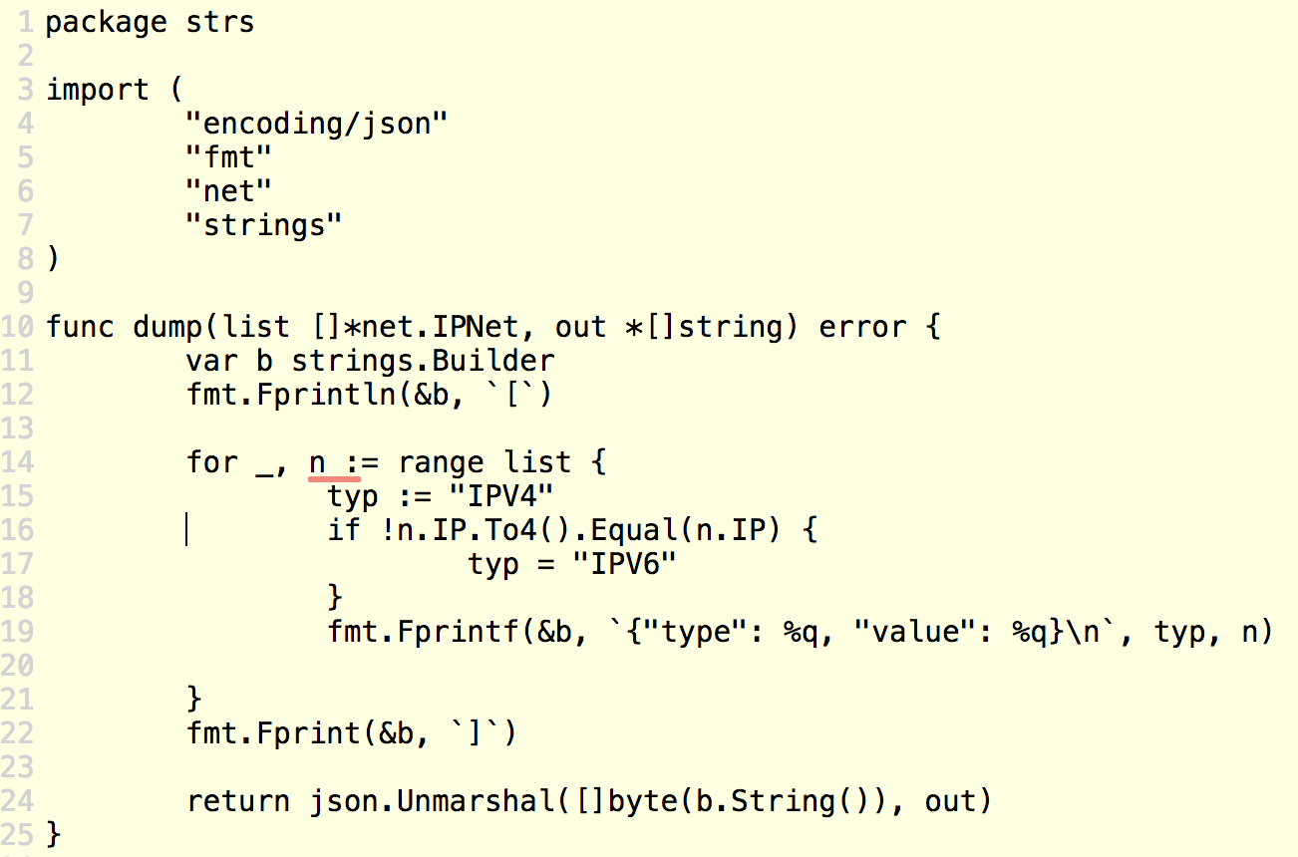

Go 1.10 Release Party
Strings.Builder
https://play.golang.org/p/1vTvsAvFTLT

Slide 5
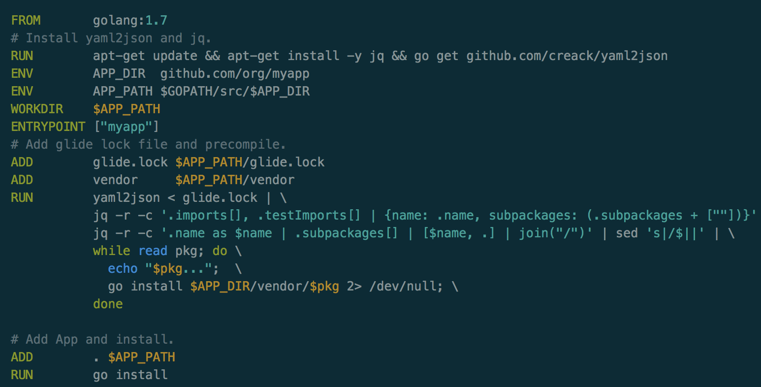
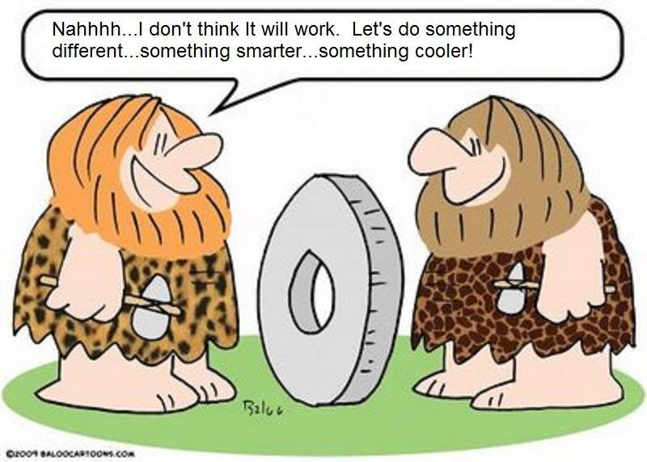
Go 1.10 Release Party
Package cache management
Beware!
This breaks IDEs (completion) and optimizations.
“The go install command now installs only the packages and commands listed directly on the command line. “
https://blog.charmes.net/post/glide-deps-cache/

Slide 6

Go 1.10 Release Party
Full blown context
context package is now the default
go fix will rewrite the old “golang.org/x/net/context”

Slide 7
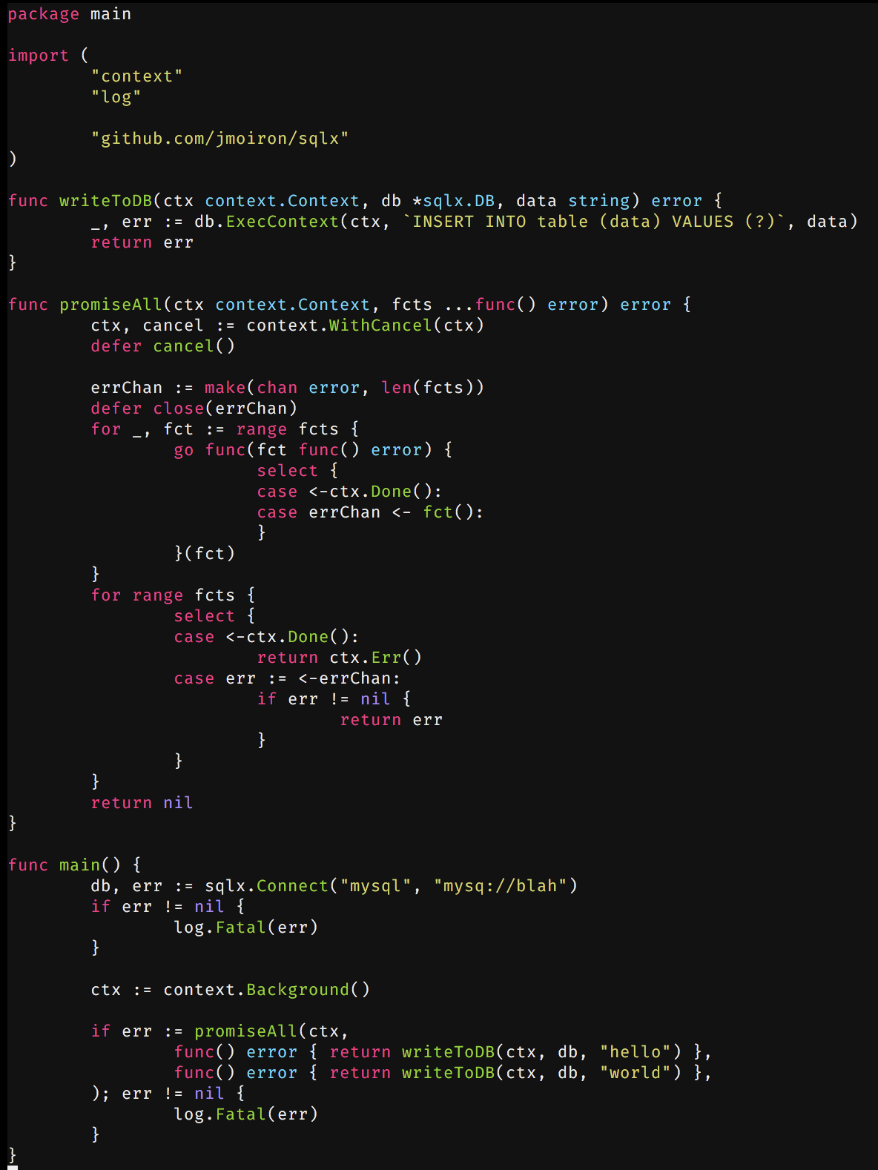
Go 1.10 Release
Party
Full blown context
Context is awesome ☺
HTTP: Cancel when client
Disconnects
DB: Interrupt upon errors

Slide 8
Go 1.10 Release Party
The rest
Test cache caveats
GC improvements
Default GOROOT
Diagnostics

Slide 9
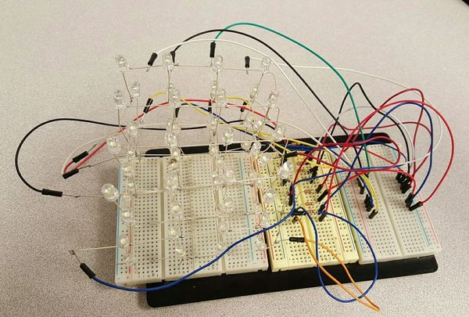

Go 1.10 Release Party
Questions?
Thank you for coming!

Slide 10




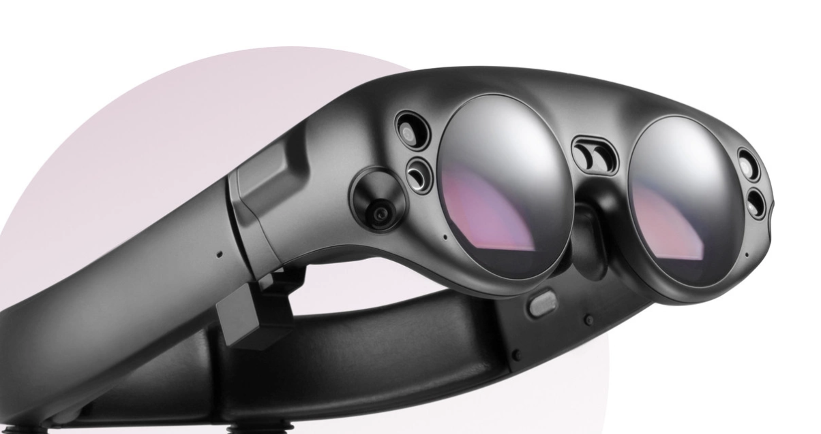
Go 1.10 Release Party
Announcements
We are hiring!
Come work with Golang for Magicleap
gcharmes@magicleap.com
Guillaume J. Charmes – Magic Leap
Twitter @charme_g
Github: @creack

